Slide 1
CS 4310: Software Engineering
Lecture 9
Object-Oriented Design II

Slide 2
Requirements: the Long Term
Believe that your software will be in use 5 years from now.
• What happens at end of semester?
Packaging and hand-over
Client's technical preferences (C++, Java)
• Some system decisions based on short-term considerations
• Which formats, protocols, etc. do you think will last?

Slide 3
Requirements, Design and Implementation
Remember the definitions.
Example: Consistency between two players of a board game
• The requirement is .....
• The design is .....
What is a requirements specification?

Slide 4
Modeling Classes
Given a real-life system, how do you decide what classes to use?
• What terms do the users and implementers use to describe the system? They are candidates for classes.
• Is each candidate class specifically defined?
• For each class, what is its set of responsibilities? Are the responsibilities evenly balanced among the classes?
• What attributes and operations does each class need to carry out its responsibilities?

Slide 5
Noun Identification: A Library Example
The library contains books and journals. It may have several copies of a given book. Some of the books are reserved for short-term loans only. All others may be borrowed by any library member for three weeks. Members of the library can normally borrow up to six items at a time, but members of staff may borrow up to 12 items at one time. Only members of staff may borrow journals.
The system must keep track of when books and journals are borrowed and returned and enforce the rules.

Slide 6
Noun Identification: A Library Example
The library contains books and journals. It may have several copies of a given book. Some of the books are reserved for short-term loans only. All others may be borrowed by any library member for three weeks. Members of the library can normally borrow up to six items at a time, but members of staff may borrow up to 12 items at one time. Only members of staff may borrow journals.
The system must keep track of when books and journals are borrowed and returned and enforce the rules.

Slide 7
Candidate Classes
Library the name of the system
Book
Journal
Copy
ShortTermLoan event
LibraryMember
Week measure
MemberOfLibrary repeat
Item book or journal
Time abstract term
MemberOfStaff
System general term
Rule general term

Slide 8
Relations between Classes
Book is an Item
Journal is an Item
Copy is a copy of a Book
LibraryMember
Item
MemberOfStaff is a LibraryMember
Is Item needed?

Slide 9
Operations
LibraryMember borrows Copy
LibraryMember returns Copy
MemberOfStaff borrows Journal
MemberOfStaff returns Journal
Item not needed yet.

Slide 10
Class Diagram
MemberOfStaff
LibraryMember
1
1
on loan
on loan
0..*
0..12
Journal
Copy
is a copy of
1..* 1
Book

Slide 11
Rough Sketch: Wholesale System
A wholesale merchant supplies retail stores from stocks of goods in a warehouse.
What classes would you use to model this business?

Slide 12
Rough Sketch: Wholesale System
RetailStore
Order
Merchant
Product
Warehouse
Shipment
Invoice

Slide 13
Rough Sketch: Wholesale System
Merchant
RetailStore
name
address
contactInfo
financialInfo
Shipment
Responsibilities
-track status of shipped products
Warehouse
Order
Product
responsibility (text field)
Reversals
damaged()
return()
wrongItem()
Invoice

Slide 14
Expanding a Class:
Modeling Financial Information
RetailStore
association
1 *
Transaction
Which class is responsible for the financial records for a store?
Payment
Invoice

Slide 15
Modeling Invoice
Shipment
???
RetailStore
invoiceRecord
goodsShipped
Invoice
invoiceNumber
+goodsShipped()
-sendInvoice()
PartsList
+ public
- private

Slide 16
Lessons Learned
There is no single correct design. During the design process:
• Elements are hidden to simplify the diagram
• Elements may be missing.
• The model may not be consistent
The diagram is not the whole design. Diagrams must be backed up with specifications.

Slide 17
Levels of Abstraction
The complexity of a model depends on its level of abstraction:
• High-levels of abstraction show the overall system.
• Low-levels of abstraction are needed for implementation.
Two approaches:
• Model entire system at same level of abstraction, but present diagrams with different levels of detail.
• Model parts of system at different levels of abstraction.

Slide 18
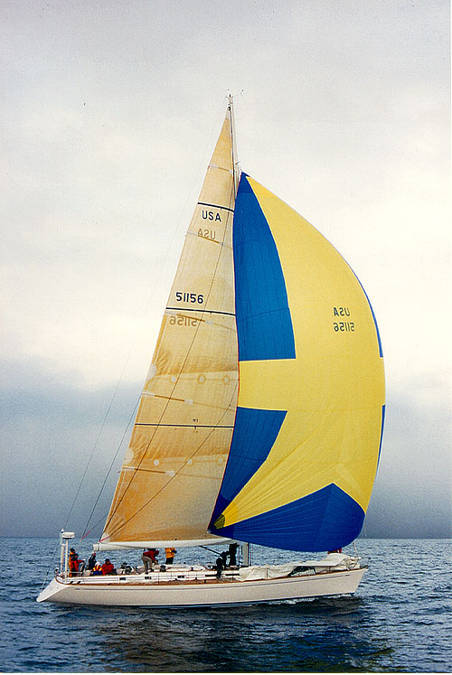
Component Diagram
executable component
hello.java
hello.hml
HelloWorld.class
hello.jpg

Slide 19
Actor and Use Case Diagram
• An actor is a user of a system in a
particular role.
An actor can be human or an external
system.
• A use case is a a task that an actor
needs to perform with the help of the
system.
BookBorrower
Borrow book

Slide 20
Use Cases and Actors
• A scenario is an instance of a use case
• Actor is role, not an individual
(e.g., librarian can have many roles)
• Actor must be a "beneficiary" of the use case
(e.g., not librarian who processes book when borrowed)
In UML, the system boundary is the set of use cases.

Slide 21
Use Cases for Borrowing Books
Borrow copy of book
BookBorrower
Return copy of book
Reserve book
Extend loan

Slide 22
Relationships Between Use Cases: <<uses>>
Extend loan
<<uses>>
Check for reservation
BookBorrower
Borrow copy of book
<<uses>>

Slide 23
Relationships Between Use Cases: <<extends>>
<<extends>>
Refuse loan
Borrow copy of book
BookBorrower

Slide 24
Use Cases in the Development Cycle
• Use cases are a tool in requirements analysis
• Intuitive -- easy to discuss with clients
• Use cases are often hard to translate into class models
• Scenarios are useful to validate design

Slide 25
Project Work
Continue to work in your teams to create your Analysis Document.
Next week, more on UML and OOD.

